Slide 1

Exploring Incompatible Knowledge Transfer in Few-shot Image Generation Yunqing Zhao¹ Chao Du² Milad Abdollahzadeh¹ Tianyu Pang² Min Lin² Shuicheng Yan² Ngai-Man Cheung¹ ¹Singapore University of Technology and Design (SUTD) ²Sea AI Lab
2024.07.17
Presented by Youngseob Won

Slide 2
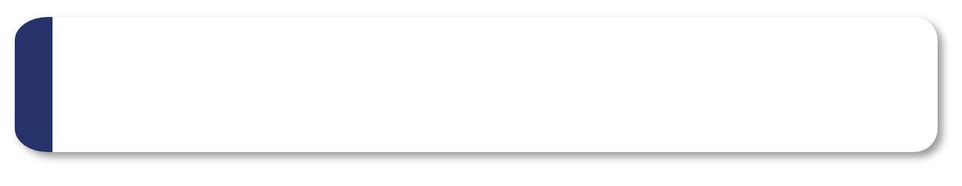
Introduction
Analysis
Method
Experiments
05
Conclusion

Slide 3
Introduction
01

Slide 4
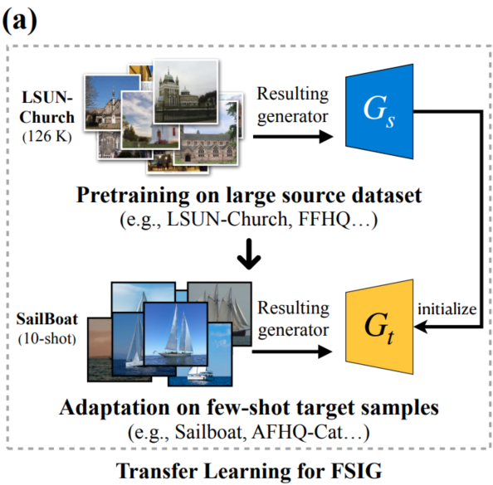
Introduction
Task: Few-shot (10-shot) image generation (FSIG)
Source generator (G_{s}) is transferred to learn target generator (G_{t}) with limited (10-shot) training examples.
Example: LSUN-Church (source) → Sailboat (target)
Meaning: Adapt source image generator pretrained on LSUN-Church dataset (size: 126K), with few-shot (10-shot) target (Sailboat) samples.

Slide 5
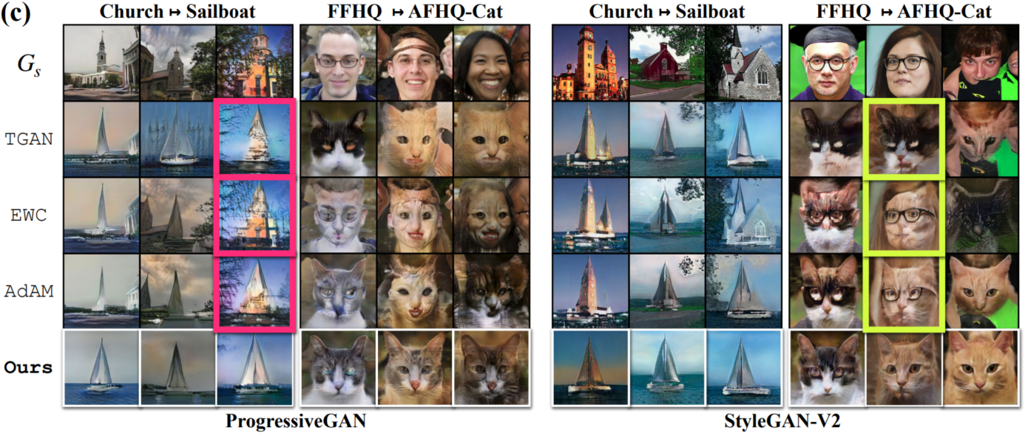
Introduction
Problem Definition: Incompatible knowledge transfer
However, existing SOTA methods (EWC[1], AdAM[2]) show a phenomenon called ‘Incompatible knowledge transfer’.
Example: LSUN-Church (source) → Sailboat (target)
Trees and buildings, which are incompatible with target (Sailboat) domain, appear in Sailboat image generation.
Source
Target
[1] Yijun Li, Richard Zhang, Jingwan (Cynthia) Lu, and Eli Shechtman, “Few-shot image generation with elastic weight consolidation”, NeurIPS 2020.
[2] Yunqing Zhao, Keshigeyan Chandrasegaran, Milad Abdollahzadeh, and Ngai man Cheung. “Few-shot image generation via adaptation-aware kernel modulation”, NeurIPS 2022.
Notes:
AdAM [75] proposes a modulation based method to identify the source knowledge important for the target domain, and preserves the knowledge for adaptation.

Slide 6
Introduction
What causes the ‘Incompatible knowledge transfer’ problem?
It is because existing FSIG methods
Focus only on knowledge preservation of source domain
While failing to prevent the transfer of knowledge that is incompatible with the target domain.
Therefore we present RICK (Removing In-Compatible Knowledge)
What is RICK? → 1. lightweight 2. filter-pruning based method to remove filters that encode incompatible knowledge during FSIG adaptation.
How? → select ‘filters with least estimated importance for adaptation’, and apply filter pruning based on importance
Notes:
While filter pruning has been applied extensively to achieve compact deep networks with reduced computation, its application to prevent transfer of incompatible knowledge is underexplored.
Extensive experiments show that our method effectively removes incompatible knowledge and consistently improves the generative quality, including challenging setups where source and target domains are dissimilar.

Slide 7
Analysis
02

Slide 8
Analysis
Investigating incompatible knowledge
Prior SOTA methods becomes invalid when source and target domains are semantically distant (e.g., Human Face → Cat Face)
Why? Assumption of ‘fine tuning can adapt the source generator to the target, such that irrelevant and incompatible source knowledge can be dropped or updated’ does not hold
It is also because prior methods mainly focused on knowledge preservation from the source (source aware), while little attention on knowledge update (target aware)
To find what are incompatible knowledge in the generator, we use GAN dissection[1], and importance probing (IP) method from [2].
[1] David Bau, Jun-Yan Zhu, Hendrik Strobelt, Bolei Zhou, Joshua B Tenenbaum, William T Freeman, and Antonio Torralba. Gan dissection: Visualizing and understanding generative adversarial networks., ICLR 2019.
[2] Yunqing Zhao, Keshigeyan Chandrasegaran, Milad Abdollahzadeh, and Ngai man Cheung. Few-shot image generation via adaptation-aware kernel modulation. NeurIPS 2022.

Slide 9
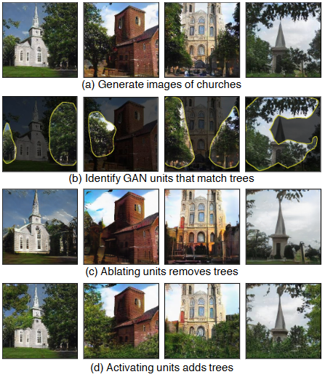
Analysis
GAN dissection[1,2]
a framework that can identify correspondence between filters and the semantic segmentation of a particular object class (e.g., tree) across difference images.
Why use GAN dissection? To disclose filters that retain incompatible knowledge after fine-tuning.
A framework that views each filter of CNN as encoding of a specific part of knowledge
Figure from [2],
[1] David Bau, Bolei Zhou, Aditya Khosla, Aude Oliva, and Antonio Torralba, Network dissection: Quantifying interpretability of deep visual representations. CVPR 2017.
[2] David Bau, Jun-Yan Zhu, Hendrik Strobelt, Bolei Zhou, Joshua B Tenenbaum, William T Freeman, and Antonio Torralba. Gan dissection: Visualizing and understanding generative adversarial networks., ICLR 2019.

Slide 10
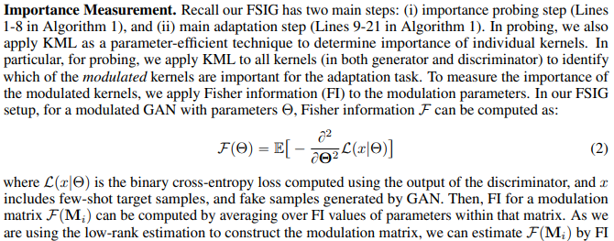
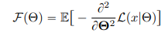
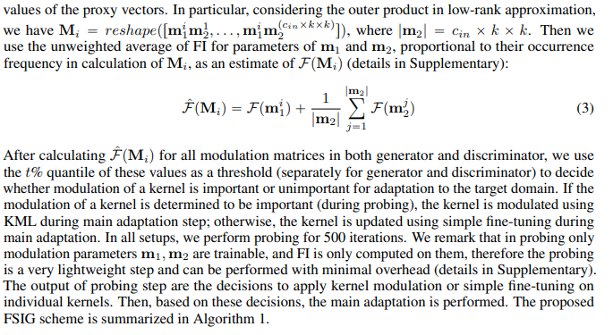
Analysis
AdAM[1]
Framework that proposes an importance probing (IP) method to determine if a source GAN filter is important for adaptation
Uses Fisher information for importance measurement. L is BCE loss of discriminator, x includes FS target samples and fake samples generated by GAN.
If importance is big, then use modulator during adaptation
If importance is small, then just fine-tune the convolutional kernel during adaptation
[1] Yunqing Zhao, Keshigeyan Chandrasegaran, Milad Abdollahzadeh, and Ngai man Cheung. Few-shot image generation via adaptation-aware kernel modulation. NeurIPS 2022.

Slide 11
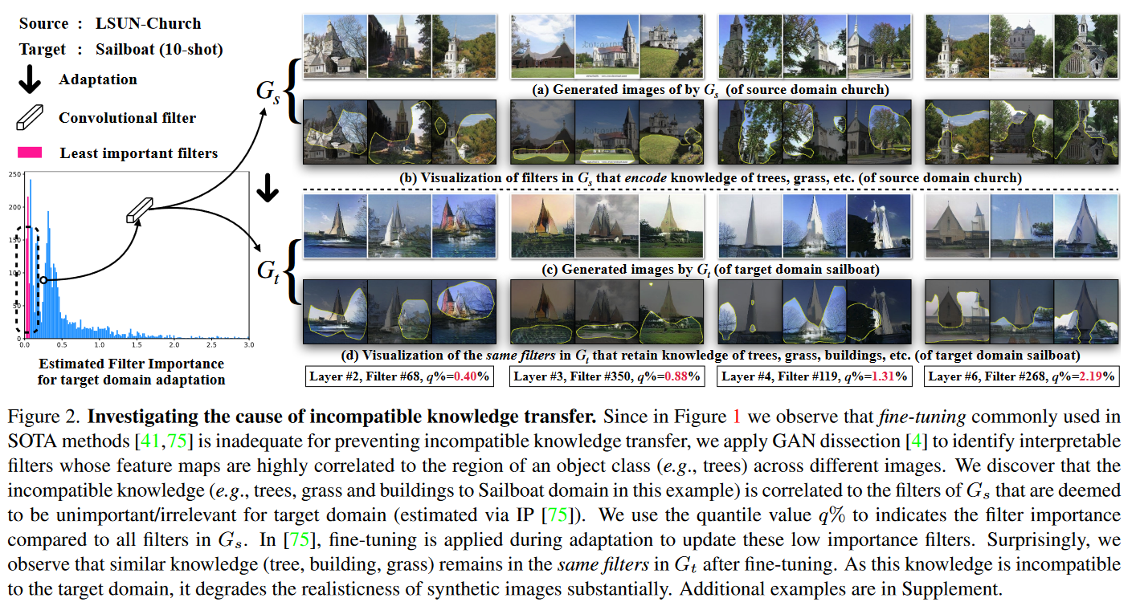
Analysis
Investigating incompatible knowledge
q = bottom q%

Slide 12
Analysis
Experiment results
Root cause of incompatible knowledge transfer is the least important filters in G_s, and fine-tuning is not adequate for removing the incompatible knowledge after adaptation.
Observation1: incompatible knowledge happens (As explained before).
Observation2: filters with least importance for target domain are mostly relevant to incompatible features transferred from the source.
Fine-tuning cannot effectively address this issue, especially when the target domains becomes distant

Slide 13
Analysis
Investigating incompatible knowledge
To understand knowledge transference before and after adaptation
Do experiments at pixel space (Visualization of images in pixel space) and filter space
Experiment 1: Generate images with fixed generator input (pixel space).
Use the same latent vector when generating images.
Experiment 2: Dissect pretrained and adapted generator. (filter space)
Using importance probing method[2], label filters of G_s, and apply GAN dissection[1] to visualize the semantic features corresponding to the same filters to G_s and G_t.

Slide 14
Analysis
Experiment setups
Generator: ProGAN, StyleGAN-V2
Source: FFHQ (human face), LSUN-Church
Target (10-shot): AFHQ-Cat (cat face), Sailboat
Evaluation methods(FSIG task methods): TGAN(baseline), EWC, AdAM
Importance measurement: use Fisher information as used in AdAM.

Slide 15
Method
03

Slide 16
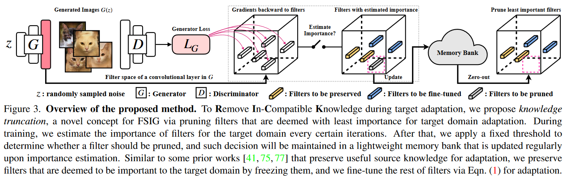
Method
Removing In-Compatible Knowledge (RICK) for the target domain is important as preserving knowledge.
Prior works propose different knowledge preservation (e.g., freezing, regularization, modulation), but we propose knowledge truncation

Slide 17
Method
Knowledge truncation via network pruning
Use pruning for improving quality of generated images
Via removing least important filters relevant to incompatible knowledge to the target domain in FSIG task.
Consists of Two steps:
1. filter importance estimation during adaptation → fisher information
2. determine operations (freeze, fine-tune, pruning) to filters based on their estimated importance.

Slide 18
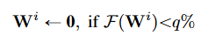
Method
5.1
We use Fisher Information (FI) [47] as importance estimator for each filter F(W)
In practice, we use first-order approximation of FI [1] to lower the computational cost.
[1] Alessandro Achille, Michael Lam, Rahul Tewari, Avinash Ravichandran, Subhransu Maji, Charless C Fowlkes, Stefano Soatto, and Pietro Perona. Task2vec: Task embedding for meta-learning. In Proceedings of the IEEE/CVF International Conference on Computer Vision, pages 6430–6439, 2019. 5, 6
[47] Sebastian Mika, Gunnar Ratsch, Jason Weston, Bernhard Scholkopf, and Klaus-Robert Mullers. Fisher discriminant analysis with kernels. In Neural networks for signal processing IX: Proceedings of the 1999 IEEE signal processing society workshop (cat. no. 98th8468), pages 41–48. Ieee, 1999. 3, 5
Knowledge truncation via network pruning
1. filter importance estimation during adaptation → fisher information
2. determine operations (freeze, fine-tune, pruning) to filters based on their estimated importance.
Pruning algorithm: , prune until p% (upper bound threshold).
“non-recoverable” when already determined to be pruned.
Design choice
Other importance metrics rather than fisher information? → class salience, reconstruction loss(in supp.)
Implemented memory bank for each filter (e.g., StyleGAN-V2: ~30M parameters, but only ~5000 array size needed)
Why need memory bank? → need three values for each filters: 1. preserve, 2. fine-tune, 3. prune

Slide 19
Experiments
04

Slide 20
Experiments
Setups
Generator: StyleGAN-V2 pretrained on FFHQ
target:
Semantically related: Babies, Sunglasses, MetFaces (common setup/practice in prior works)
Distant domains:: AFHQ-Cat, AFHQ-Dog, AFHQ-Wild (more challenging compared to prior works)
GPU: NVIDIA A100 PCIe 40GB
Evaluation measurements
FID (Frechet Inception Distance) (↓): for quality (fidelity) of generated images
intra-LPIPS (Learned Perceptual Image Patch Similarity) (↑): for diversity of generated images

Slide 21
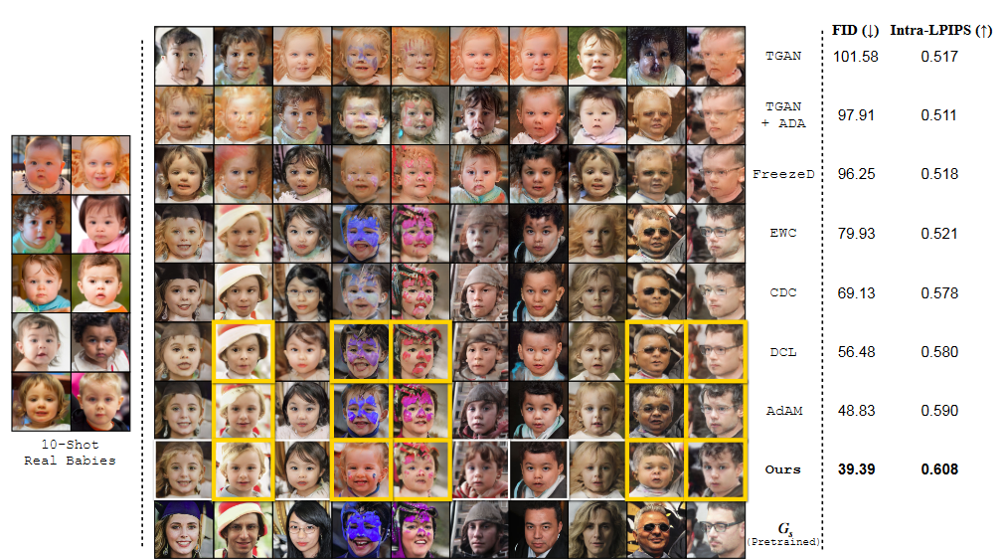
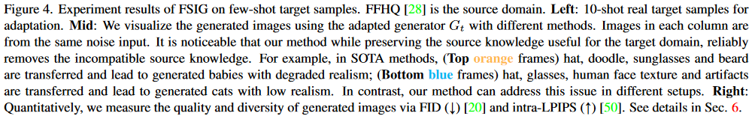
Experiments
Qualitative results
Semantically related (FFHQ (human face) → Babies)

Slide 22
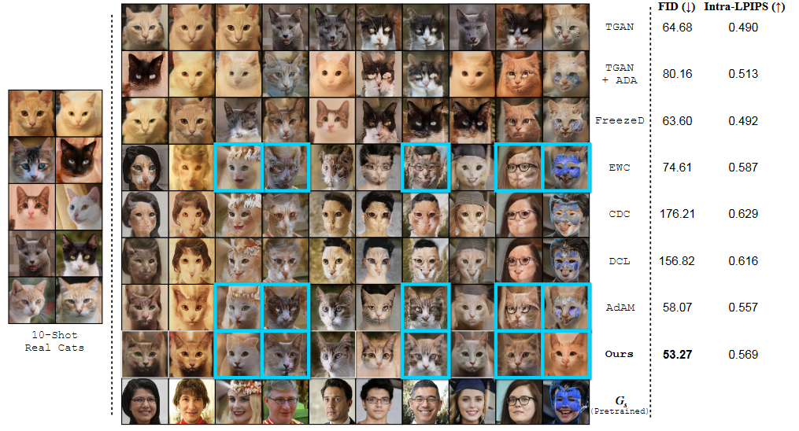
Experiments
Qualitative results
Semantically distant (FFHQ (human face) → AFHQ-Cat)

Slide 23
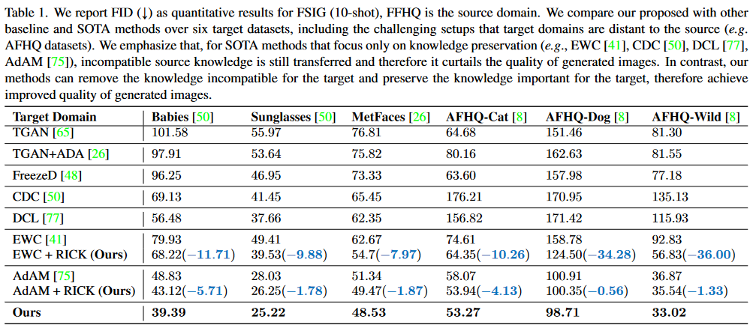
Experiments
Quantitative results

Slide 24
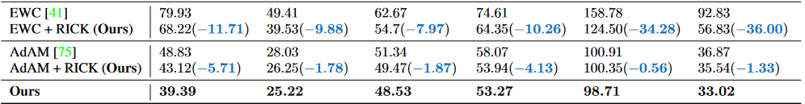
Experiments
Discussion
Knowledge truncation with different methods
EWC directly estimates the parameter importance on the source dataset of Gs
AdAM uses a modulation based method to estimate the Gs parameter importance on the target dataset.
Therefore, in Table 1, we also show the results of applying our proposed knowledge truncation to EWC and AdAM.
As our method can effectively remove the incompatible knowledge by pruning least important filters, we can achieve consistent improved performance on different datasets.

Slide 25
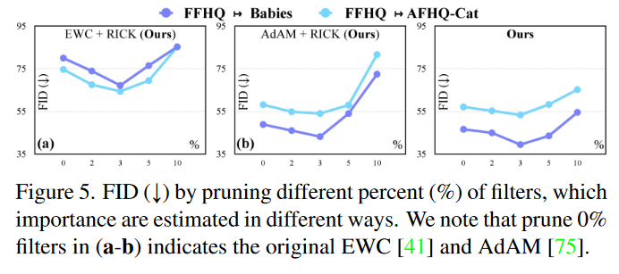
Experiments
Discussion
Prune different percent of filters.
Ideally, if we prune more filters, some important knowledge will be removed and the performance will be degraded accordingly.
3% was optimal (experimentally)

Slide 26
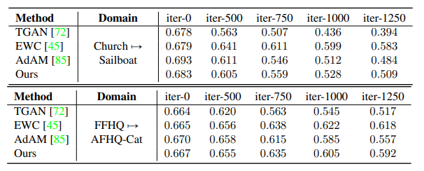
Experiments
Discussion
Can we train longer to remove the incompatible knowledge?
Ideally, an intuitive and potentially useful way to remove the incompatible knowledge is to simply train longer iterations
however, for existing FSIG methods, as the target set contains only 10-shot training images, training longer iterations will let the generator overfit and tend to replicate the few-shot target samples (supp. Figure 9)

Slide 27
Conclusion
05

Slide 28
Conclusion
Conclusion
Advantages of proposed method
Knowledge truncation for incompatible knowledge via pruning filters with least importance for adaptation
Lightweight in terms of computational cost(fisher information which uses gradient)
Can be applied to various GAN based adaptation setups
Achieve SOTA performance.
Limitation
Study on VAE, Diffusion models are one of the future works.
p%, the pruning percentage is a hyperparamter → experiment extensive, computational cost extensive.
Viewing knowledge as a filter → is this valid enough? Maybe different approach for viewing knowledge is needed.

Slide 29
wysgene19@khu.ac.kr

Slide 30
Introduction, supp.
So what is ‘Incompatible knowledge transfer’ problem?
Incompatible knowledge appears on target generator.
Incompatible knowledge: knowledge in source domain that is complement/orthogonal to target domain
Incompatible knowledge example: Trees and buildings in LSUN-Church(source) → Sailboat(target) transfer situation.
Source
Target
Notes:
While filter pruning has been applied extensively to achieve compact deep networks with reduced computation [19, 57, 66], its application to prevent transfer of incompatible knowledge is underexplored.

Slide 31
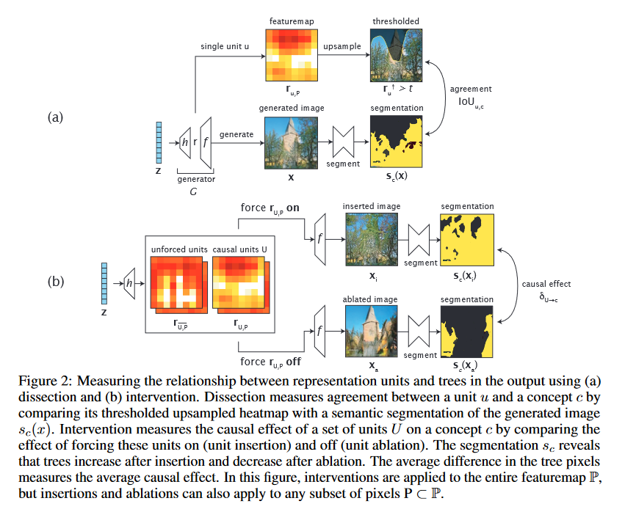
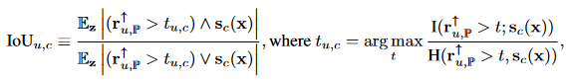
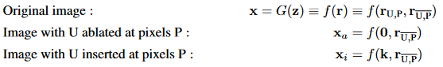
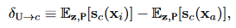
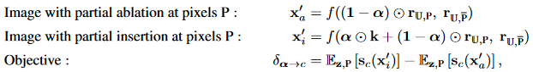
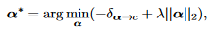
Analysis, supp.
GAN dissection[1,2]
Why use GAN dissection? To disclose filters that retain incompatible knowledge after fine-tuning.
Figure from [2],
Detailed explanation at supp.
[1] David Bau, Bolei Zhou, Aditya Khosla, Aude Oliva, and Antonio Torralba, Network dissection: Quantifying interpretability of deep visual representations. CVPR 2017.
[2] David Bau, Jun-Yan Zhu, Hendrik Strobelt, Bolei Zhou, Joshua B Tenenbaum, William T Freeman, and Antonio Torralba. Gan dissection: Visualizing and understanding generative adversarial networks., ICLR 2019.

Slide 32
Analysis, supp.
GAN dissection[1,2]
Why use GAN dissection? To disclose filters that retain incompatible knowledge after fine-tuning.
Figure from [2],
Detailed explanation at supp.
[1] David Bau, Bolei Zhou, Aditya Khosla, Aude Oliva, and Antonio Torralba, Network dissection: Quantifying interpretability of deep visual representations. CVPR 2017.
[2] David Bau, Jun-Yan Zhu, Hendrik Strobelt, Bolei Zhou, Joshua B Tenenbaum, William T Freeman, and Antonio Torralba. Gan dissection: Visualizing and understanding generative adversarial networks., ICLR 2019.

